Slide 1

Cover Letter
Session VII: Career Exploration

Slide 2
Chapter outlines
What Is a Cover Letter?
Characteristics of an Effective Cover Letter
Student cover letter

Slide 3
LEARNING OBJECTIVES
By the end of this section, you will be able to:
Define the purpose and contents of a cover letter
Identify characteristics of an effective cover letter

Slide 4
Cover letters matter. When you have to go through a pile of them, they are probably more important than the résumé itself.
—woodleywonderworks

Slide 5
1. A cover letter is
A letter of introduction, usually 3–4 paragraphs in length, that you attach to your résumé.
It’s a way of introducing yourself to a potential employer and explaining why you are suited for a position.
Employers may look for individualized and thoughtfully written cover letters as an initial method of screening out applicants who may who lack necessary basic skills, or who may not be sufficiently interested in the position.

Slide 6
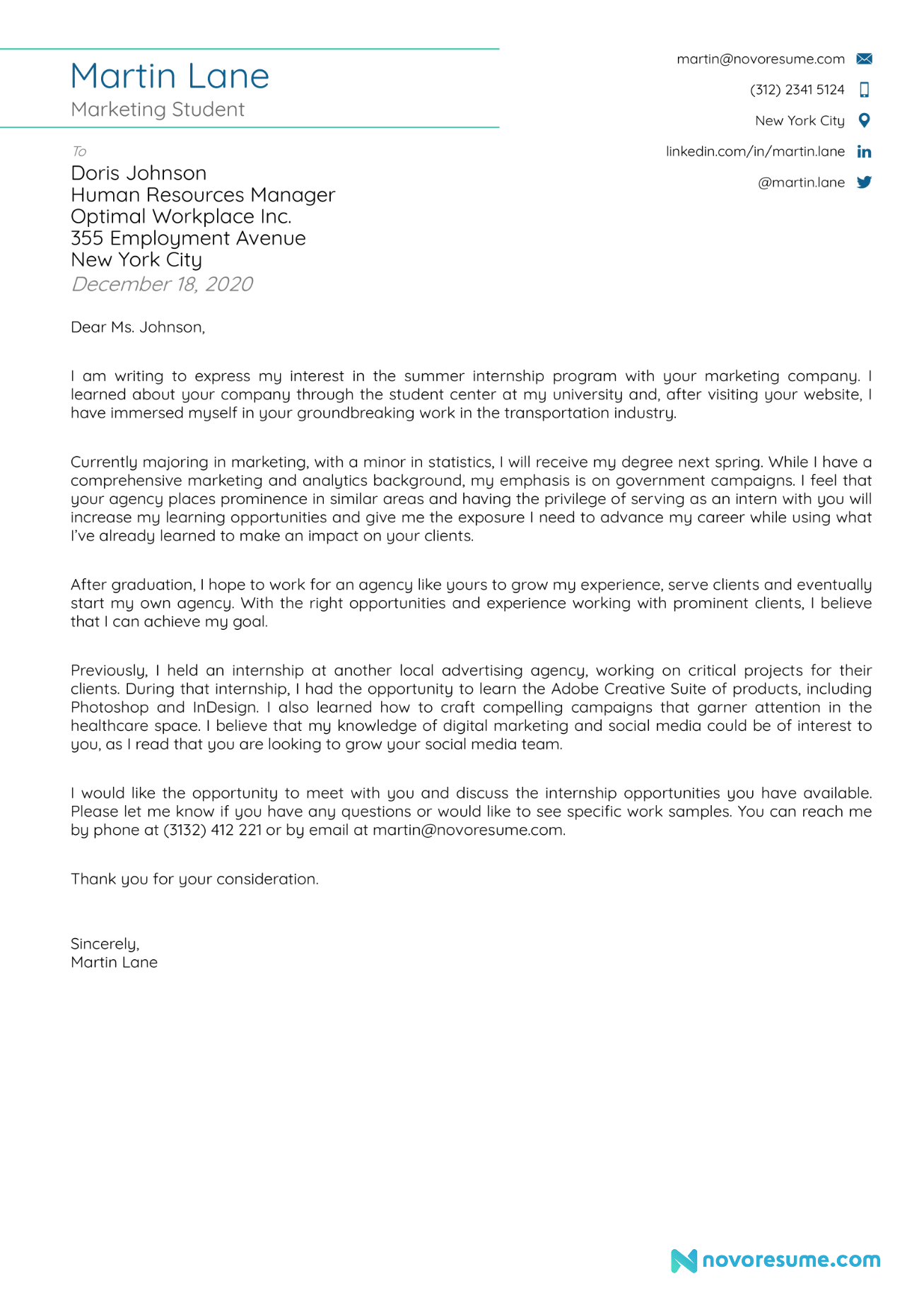
Example a cover letter

Slide 7
2. Characteristics of an Effective Cover Letter
Cover letters should accomplish the following:
Get the attention of the prospective employer
Set you apart from any possible competition
Identify the position you are interested in
Specify how you learned about the position or company
Present highlights of your skills and accomplishments
Reflect your genuine interest
Please the eye and ear

Slide 8
3. Student cover letter
What to Include in Your Cover Letter?
The job experience is not the only thing that shows your abilities
You can also mention volunteer work, academic achievements, participation in clubs or activities (particularly those in which you held leadership roles), and internships.
Your academic background is also an asset.
Include details that are relevant to the position you want (use the job description as your guide to the qualities and training the employer seeks).

Slide 9
If you are an honors student with a GPA higher than 3.5, it is a good idea to mention this on a cover letter as well, along with any honors societies you have been inducted into.
Other things you can mention are soft skills – interpersonal “people” skills like creative thinking, communication, teamwork, or time management that will help you to adapt easily to the people and clients or customers you will be working with.
Your goal in this cover letter is to show how you would be an asset to the company, describing the skills you bring that would allow you to perform well in the position

Slide 10
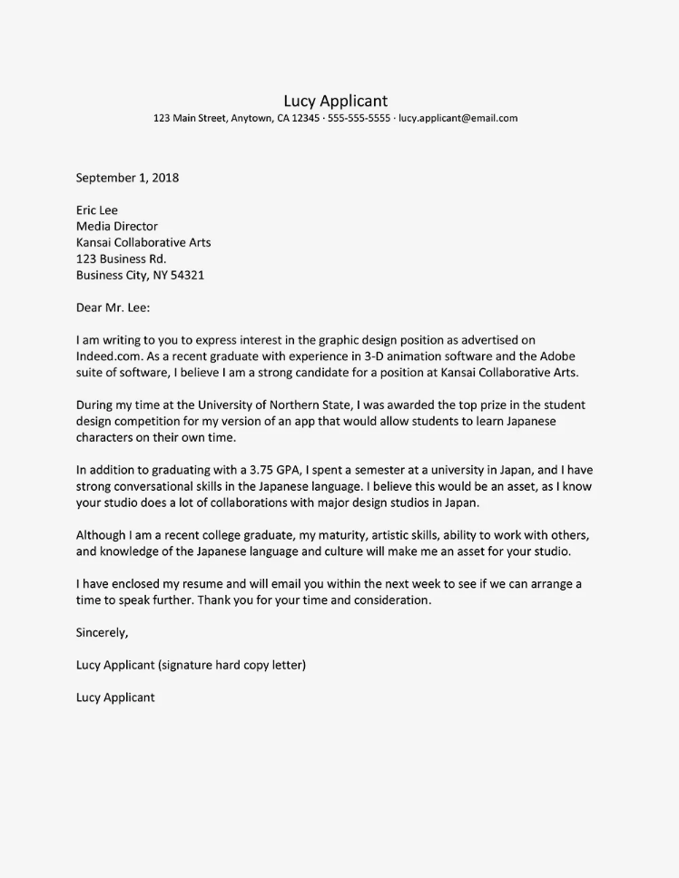
Example of student cover letter

Slide 11
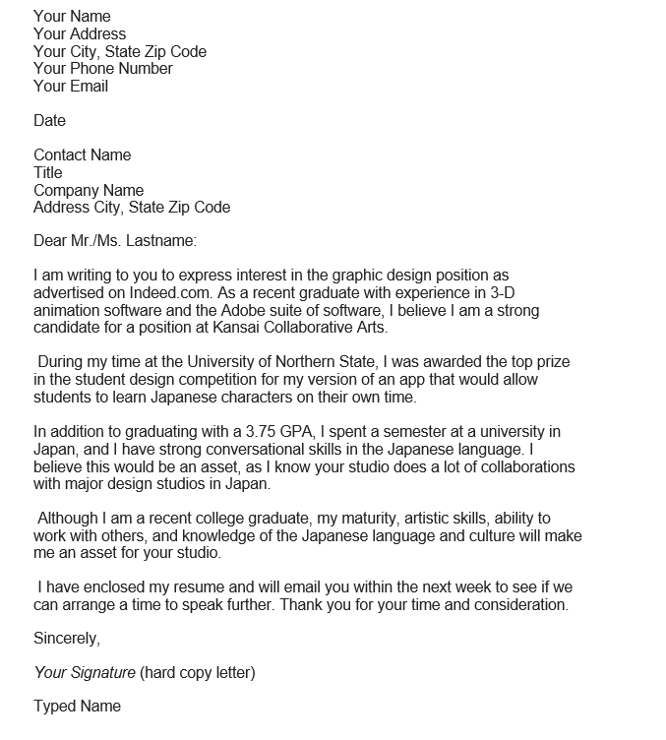
College Graduate Cover Letter Example

Slide 12
LinkedIn Cover Letter
This site contains articles, experts, jobs, and more: get all the professional insights you need on LinkedIn: https://www.linkedin.com/

Slide 13
Anatomy of a Cover Letter
A basic formula for cover letters is as follows:
Standard business letter address format—prospect name, title, company, address—top left
Salutation (yes, it should be to a real person—take time to know your target)
First paragraph—why you are writing? To meet that company's specific need(s)!
Second paragraph—briefly state two or three top skills (from the Summary section of your resume), then immediately follow with the benefits these features (and you as a person) will provide to the company.
Third paragraph—close! Not just the ending of the letter, but the "sales closer" to the letter. Close the sale. Give your target contact a specific action to take and a backup action you will take if you do not get a response.

Slide 14
Your Cover Letter: It’s Like Online Dating
Sending a Message—The Cover Letter
After searching through dozens of profiles, online daters generally find a handful of people they can picture themselves with. There’s only one way to find out more about the person, and that’s by sending the first message.
The challenging part of the first message I send through online dating sites is determining what to say. I’ve never met these people before, but I do have access to their dating profiles filled with their hobbies, hometowns, and more. This is a perfect starting point for my message, especially if we both root for the same football team or if the other person likes to run as much as I do.
Your cover letter serves as an introduction to your future employer and should complement your résumé to create a shining first impression. It is incredibly challenging to sit in front of a blank screen trying to find a good starting point, which means you should look at the job posting and organization’s Web site for ideas about what to include.
Generally, these job postings provide a set of hard skills (such as proficiency with certain technology) and soft skills (such as public speaking, teamwork, or working in a flexible environment) required and desired for the posted position. This information provides you a list of what should be explained in your cover letter. Demonstrating your hard skills is a simple enough task by using examples or stating certifications, but describing your soft skills may require a little more thought. These soft skills can be exhibited by discussing specific examples of past experiences in previous jobs you’ve held, volunteer work, or work you’ve done in college classes.
After you have crafted your cover letter, you should send it to a few people you trust for their opinion and overall proofreading along with the job posting for their reference. It’s obvious that your cover letter should be free of spelling and grammar errors, but these trustworthy individuals will also be able to provide helpful insight about the examples you’ve used to display your soft skills.
—Jackie Vetrano, Foundations of Academic Success: Words of Wisdom

Slide 15
Activity
Write a cover letter, think about where you want to work, the job you really enjoy and are capable of.
Draft and finalize your cover letter and share it with your classmates.

Slide 16


